Slide 1
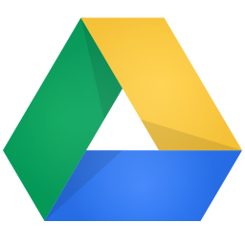
Google Drive DEV on Android
xiaokang

Slide 2
Why Share?
Improve self technical skills
Check by other member
Maybe useful for member
Assert for organization
Start share

Slide 3
INDEX
Prepare on android phone
Register on Google console
Prepare libs
Coding

Slide 4
INstALL Google PLAY Service
Prepare on android phone

Slide 5
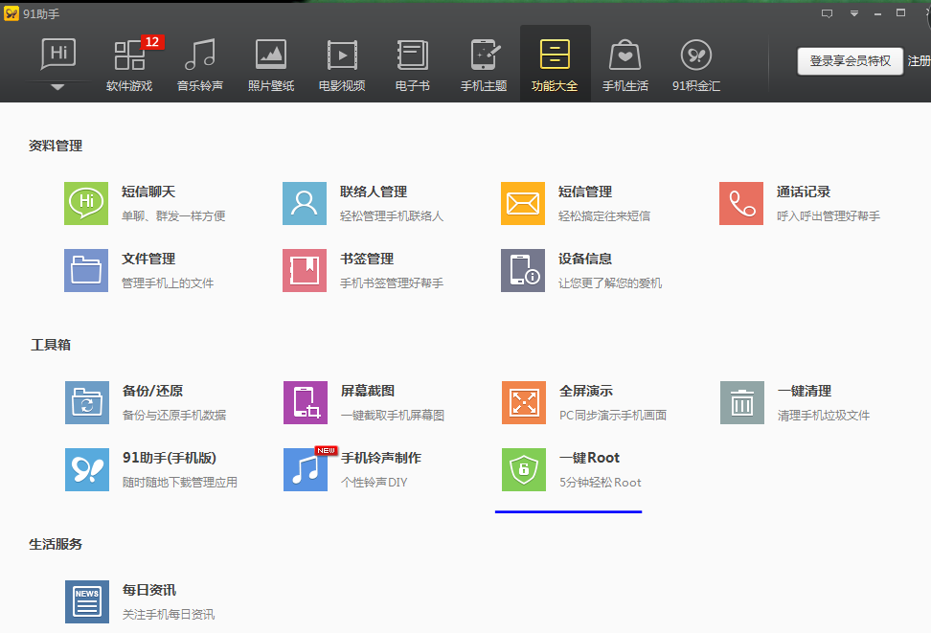
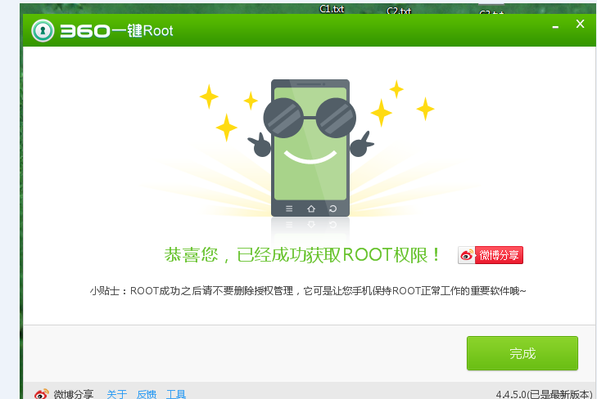
INstALL Google PLAY Service(1)
Root Phone, by 91 or 360

Slide 6
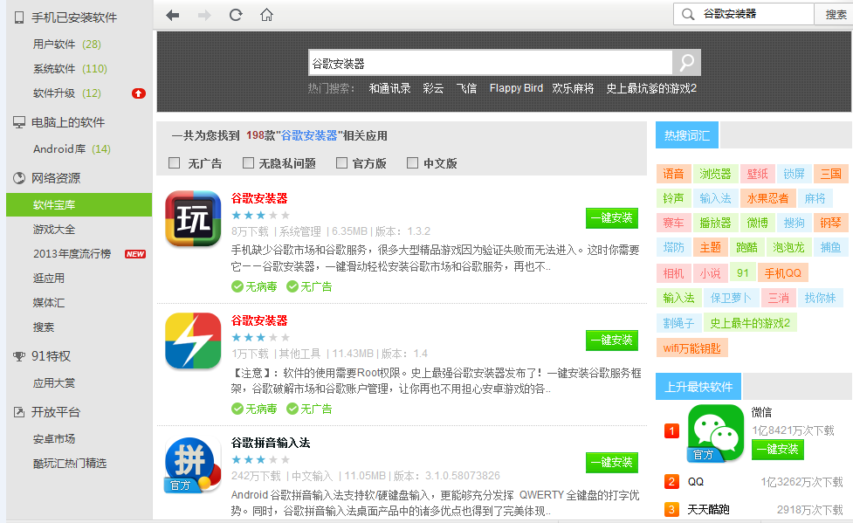
INstALL Google PLAY Service(2)
Search [谷歌安装器]

Slide 7
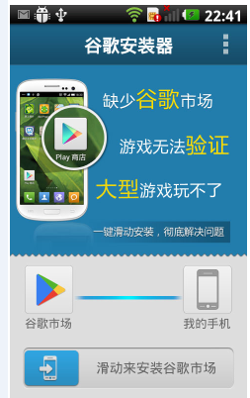
INstALL Google PLAY Service(3)
Install Google play service

Slide 8
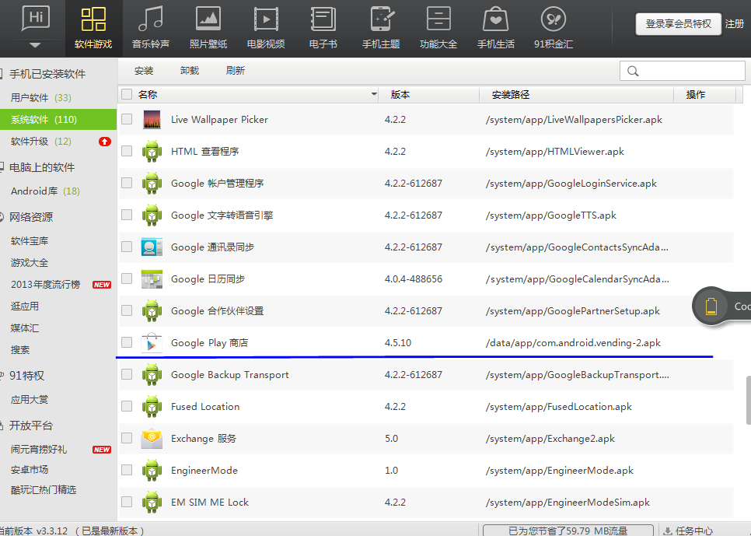
INstALL Google PLAY Service(4)
Maybe need to update again

Slide 9
INstALL Google PLAY Service(5)
Check available or not.
Open Google play or use Seagate backup to verify .
Check by code

Slide 10
VPN

Slide 11
Register on Google console

Slide 12
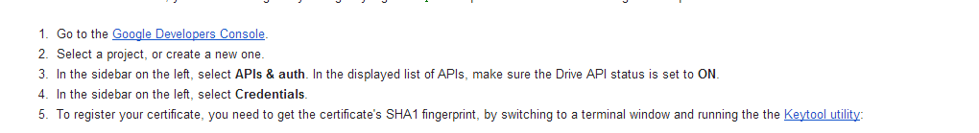
Get started
https://developers.google.com/drive/android/get-started

Slide 13
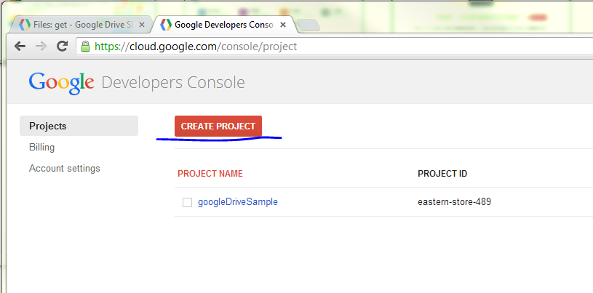
Register Google console(1)
Click to Create project
https://cloud.google.com/console/project

Slide 14
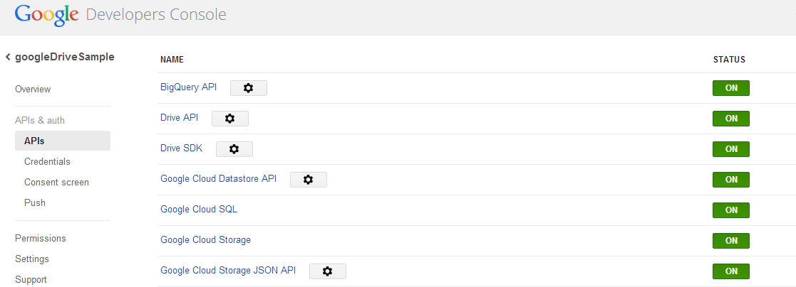
Register Google console(2)
Turn on these API in APIs&auth

Slide 15
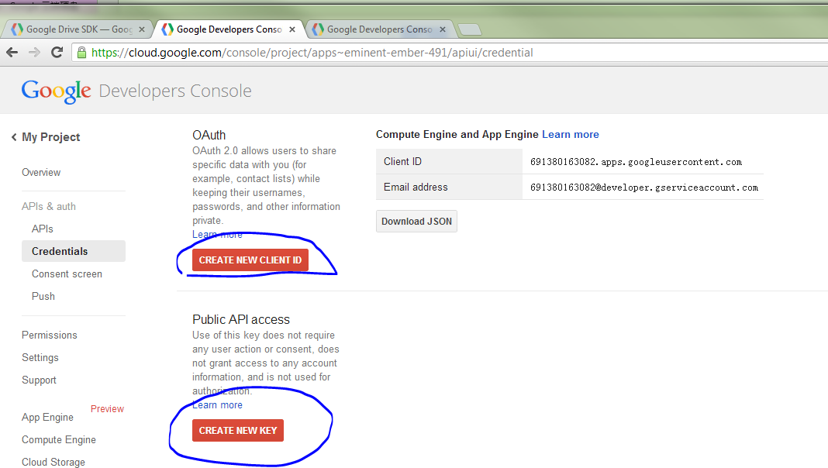
Register Google console(3)
Edit Credentials

Slide 16
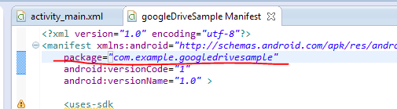
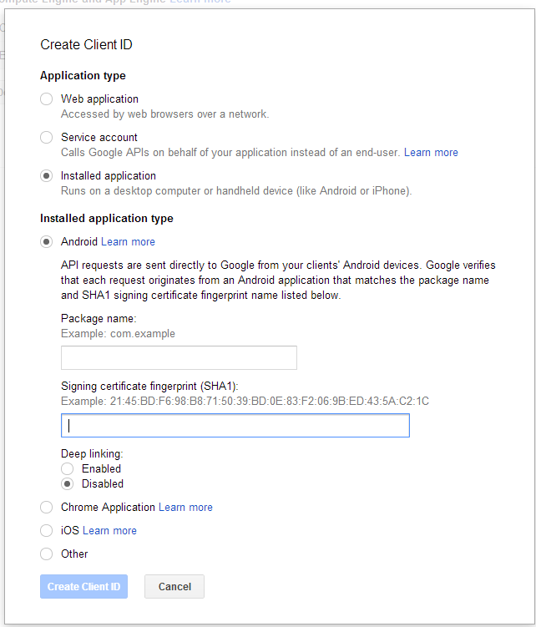
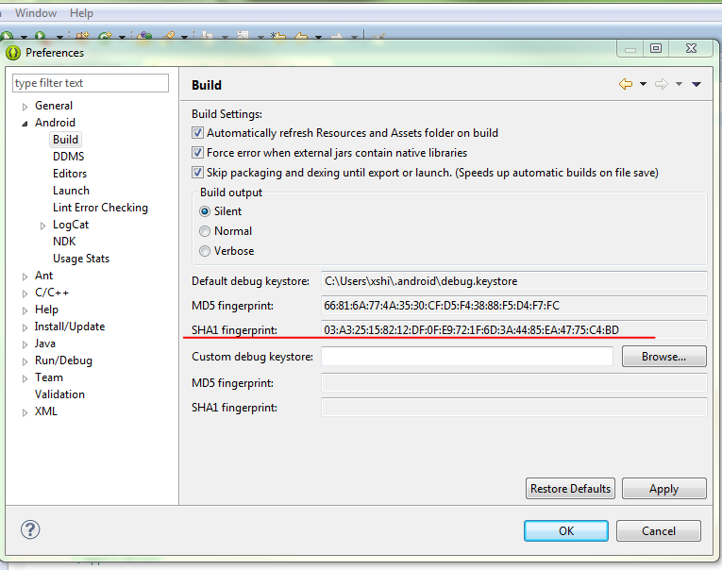
Register Google console(4)
Create client id

Slide 17
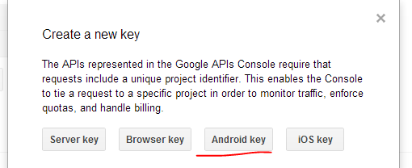
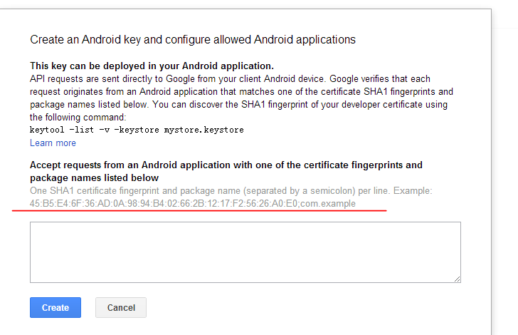
Register Google console(5)
Create new key

Slide 18
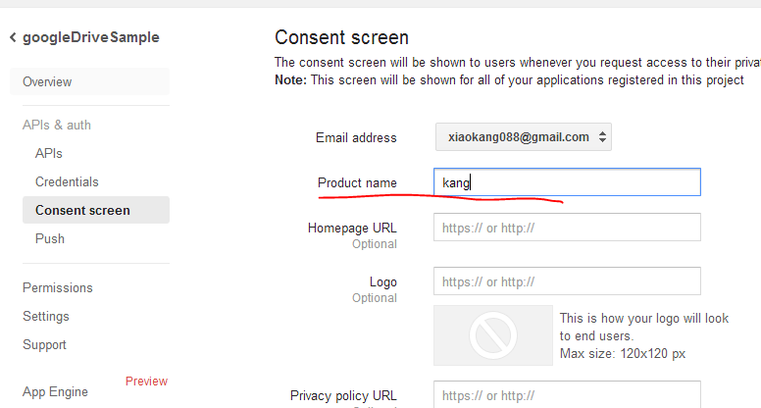
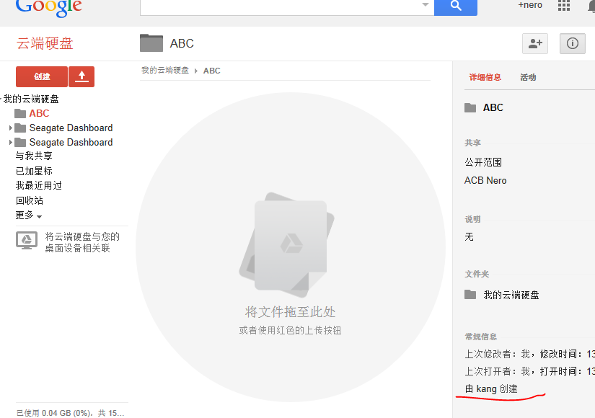
Register Google console(6)
Set product name

Slide 19
Create project & Prepare libs

Slide 20
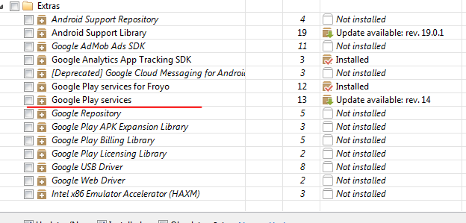
Download Google play service

Slide 21
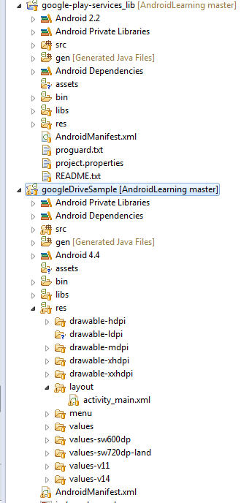
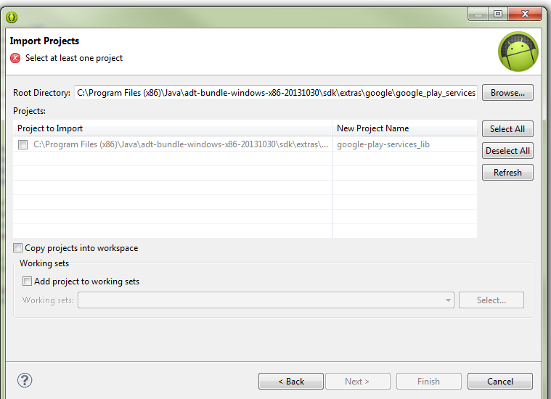
Import lib to project

Slide 22
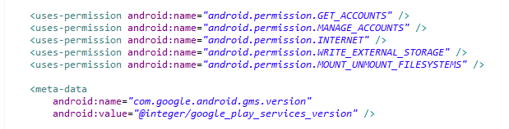
add permission and meta-data
Add these in AndroidManifest.xml

Slide 23
Add drive libs
Download the Google Drive Java client library, which is bundled as a ZIP file with all the required dependencies.
Extract the ZIP file
Add all of the JARs within the libs directory to your classpath.

Slide 24
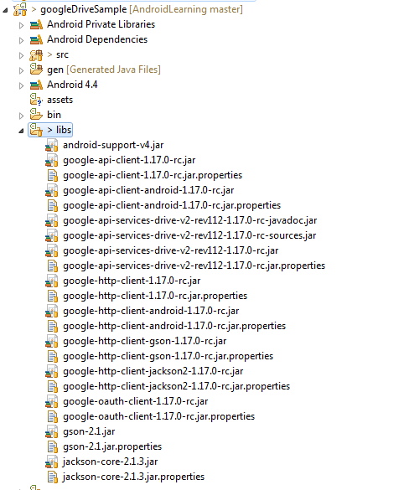
Copy jar to libs

Slide 25
Coding

Slide 26
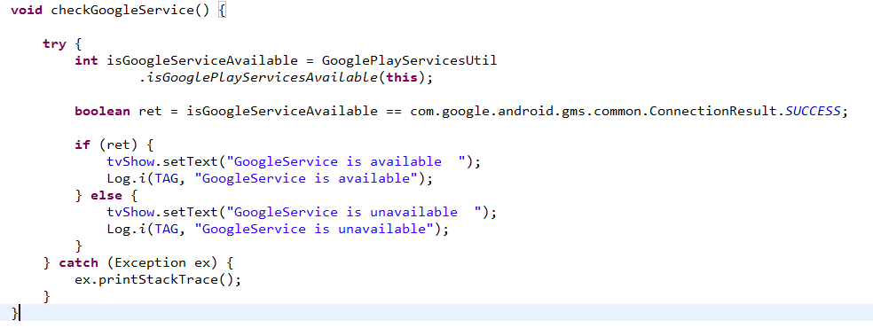
Check google play service

Slide 27
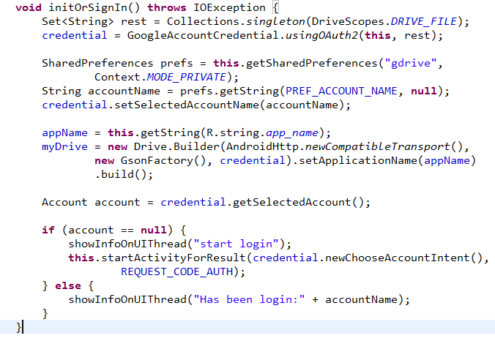
Init GooleDrive
If has been login, use it, otherwise, start to login.
Notes:
java.lang.SecurityException: caller uid 10161 lacks any of android.permission.GET_ACCOUNTS
com.google.api.client.googleapis.extensions.android.gms.auth.GoogleAuthIOException
com.google.android.gms.auth.UserRecoverableAuthException: NeedPermission

Slide 28
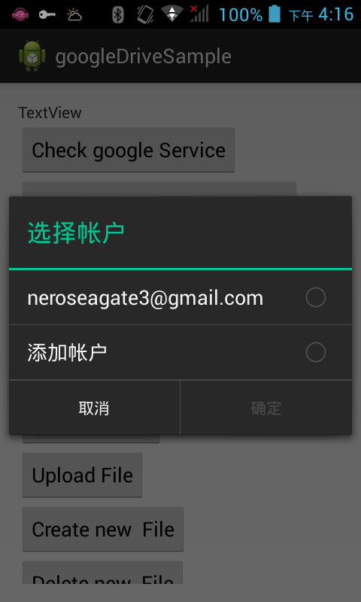
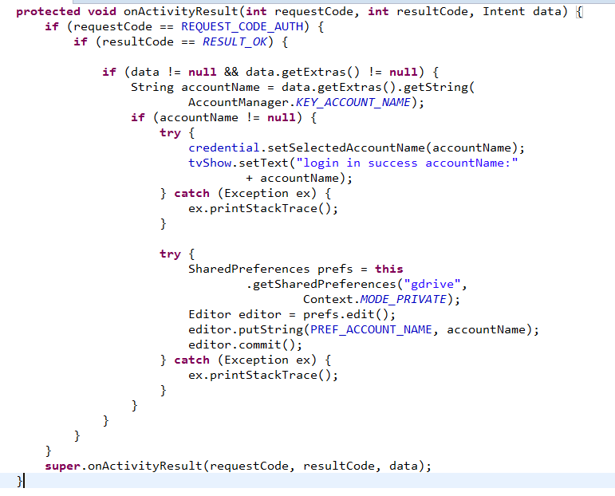
Login google account

Slide 29
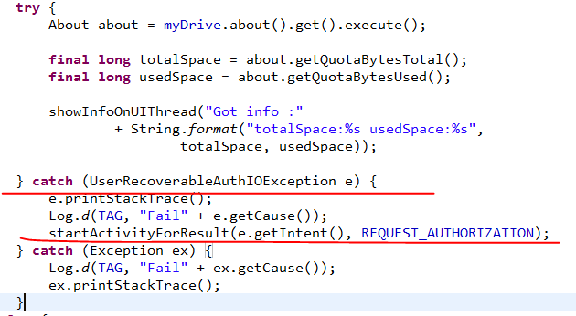

Get total/free space
About (https://developers.google.com/drive/v2/reference/#About)

Slide 30
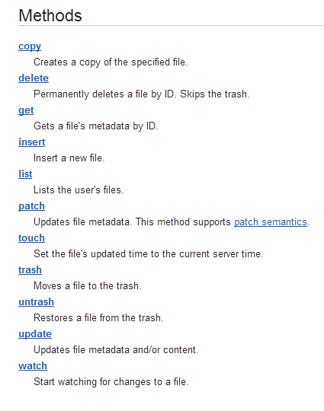
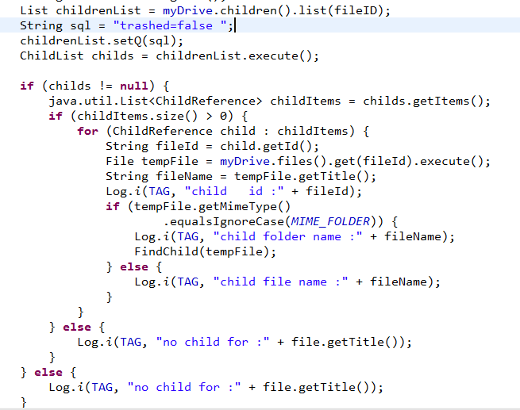
Files
(https://developers.google.com/drive/v2/reference/files#resource)

Slide 31
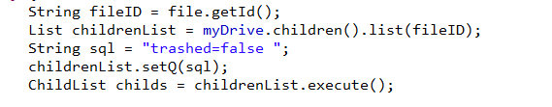
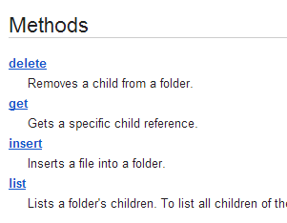
children
Take care the sql

Slide 32
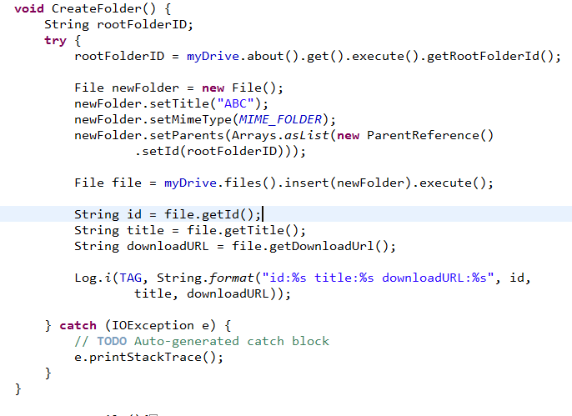
Create FOlder

Slide 33
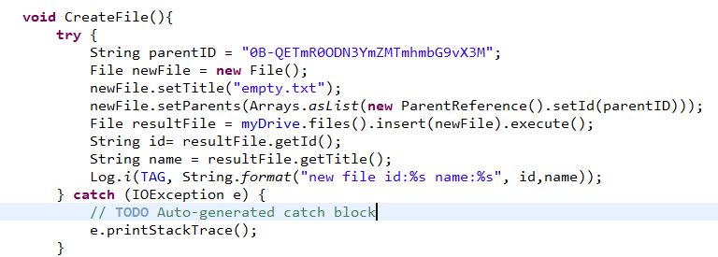
Create File
Create a empty file, no content

Slide 34
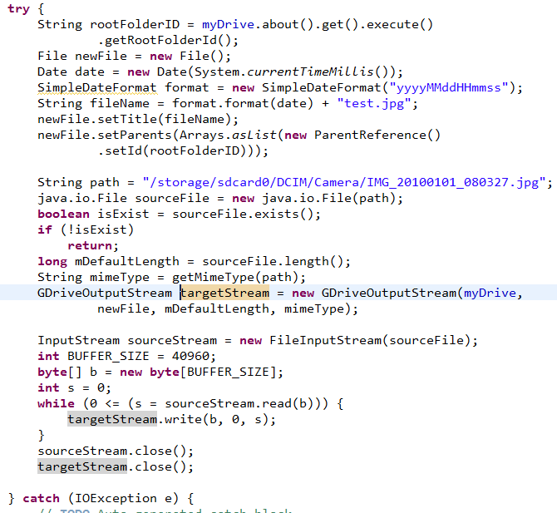
Upload file

Slide 35
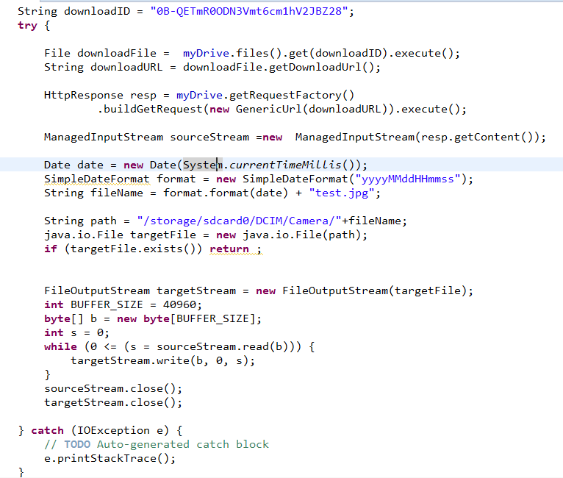
Download File

Slide 36
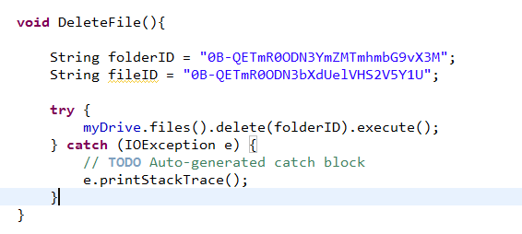
Delete File/Folder
Sometimes, can’t delete folder that have children.

Slide 37
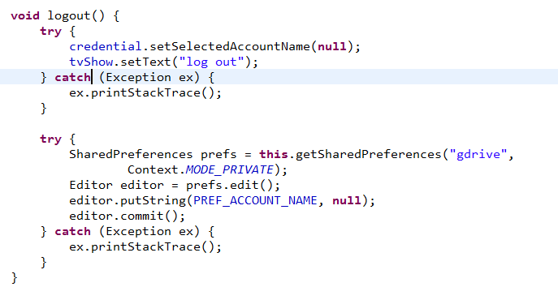
logout

Slide 38
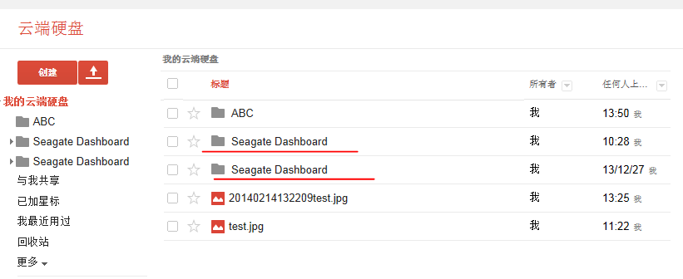
SUmmary
1. Google Drive all same folder name

Slide 39
SUmmary
2. can’t get files created by other app

Slide 40
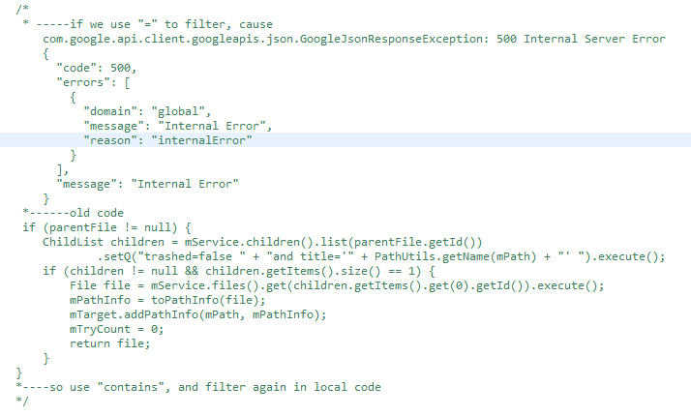
SUmmary
3. sometimes change API, no announcement
.

Slide 41
SUmmary
4. FileSystem structure is like table ,not tree.
One file can have more than 1 parent.

Slide 42
Reference
https://developers.google.com/drive/android/get-started
Code : https://github.com/xiaokang088/AndroidLearning/tree/master/googleDriveSample

Slide 43
Question ?

Slide 44
Thank you!

